Slide 1

SmartStay24
Luca, Markus, Paul, Sebastian
Ich brauche Pause von der Uni. Was sind coole Hotels mit Pool in Copenhagen

Slide 2
01
Idea

Slide 3
Approach
Parse ->
Filter ->
Rank
A great presentation for a pitch deck should be concise, clear and easy to understand. Visual elements such as charts, graphs, images, and videos can help to make the presentation engaging
When it comes to picking investors for a pitch deck, it's important to research potential investors and understand their preferences, goals and interests
The value of a product is determined by how much customers are willing to pay for it. It's a combination of factors, including the quality of the product, its features, and how well it meets customer needs

Slide 4

Unsere Lösung
Keep it simple
Use visuals
Keep it short
Structure your pitch deck clearly and make sure all the important points are easy to understand
Incorporate visuals or graphics to illustrate your message and keep the audience engaged
A good pitch deck should be concise and clear; avoid trying to cram in too much information
Make it great
Test & iterate
Main points
Include impactful stories, statistics, or facts that will help your audience remember your
message afterwards
Practice presenting your deck beforehand with friends or colleagues for feedback, then use this input to refine it further
A pitch deck is an overview of your business; focus on key points that get the most important ideas across

Slide 5
Unsere Lösung
Idee
Structure your pitch deck clearly and make sure all the important points are easy to understand
Make it great
Include impactful stories, statistics, or facts that will help your audience remember your
message afterwards

Slide 6
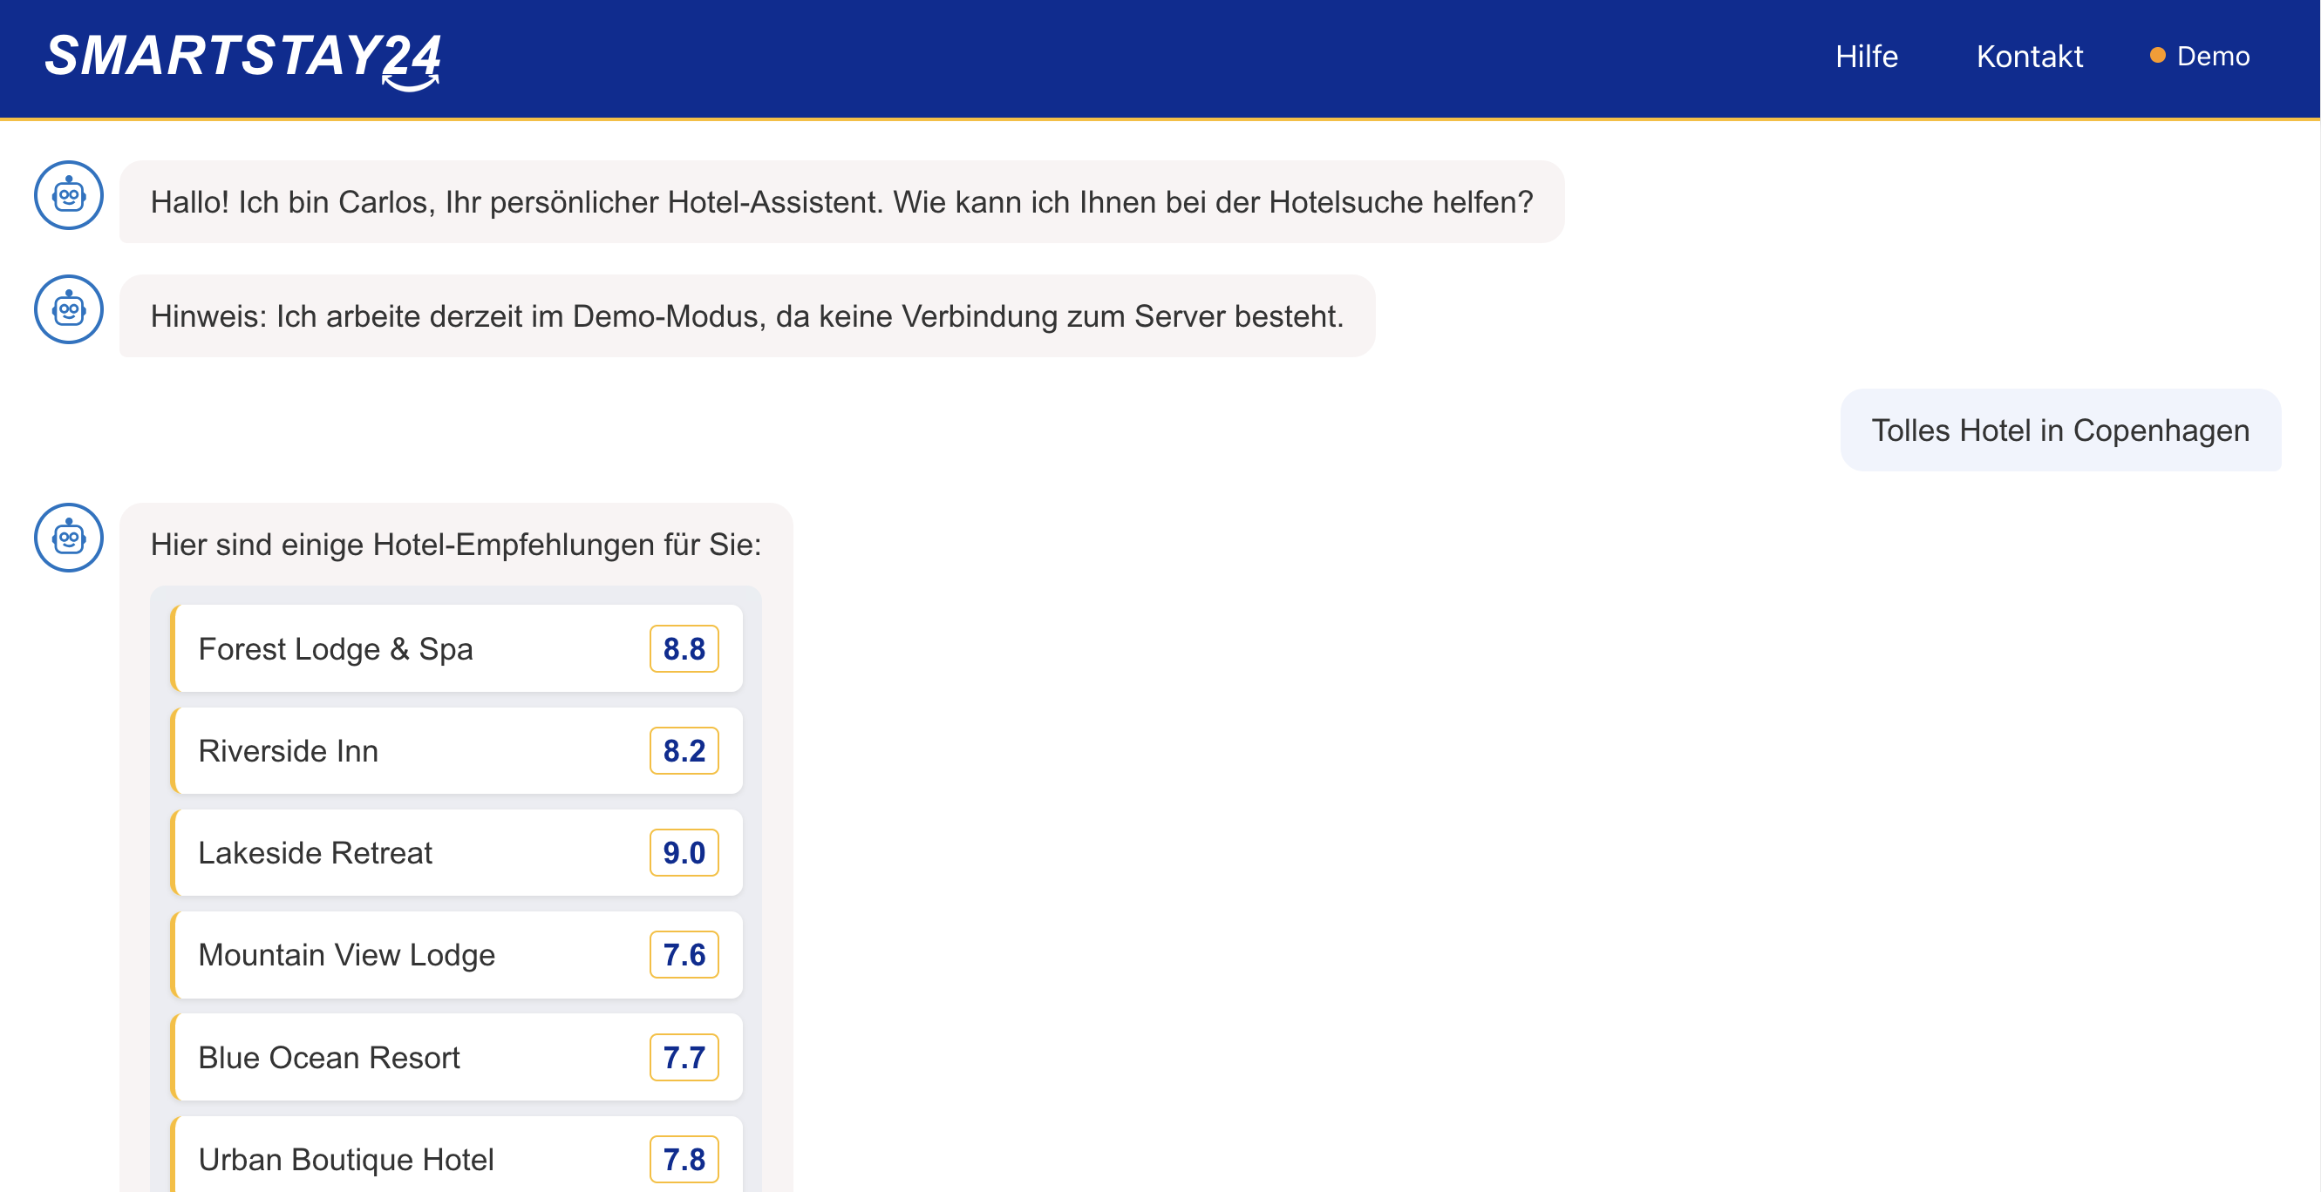
Demo

Slide 7


Thanks!
Do you have any questions?
https://github.com/eixfachZabii/hotel-recommender-smartstay24/tree/main
Please keep this slide for attribution
Thank you for your attention!

